Slide 1
Best Practices in
Citation Verification and Technical Editing
Dean Darby Dickerson
darby@law.stetson.edu

Slide 2
NCLR Code of Ethics
“The law review staff's primary substantive function is to ensure the accuracy of the manuscript in terms of its clarity of language, correctness of grammar, and completeness and accuracy of research and analysis.”

Slide 3

Overview
Citation “nightmares”
Training editors
Training staff
Due diligence for nontraditional sources
Tips for technical editing
Q&A

Slide 4
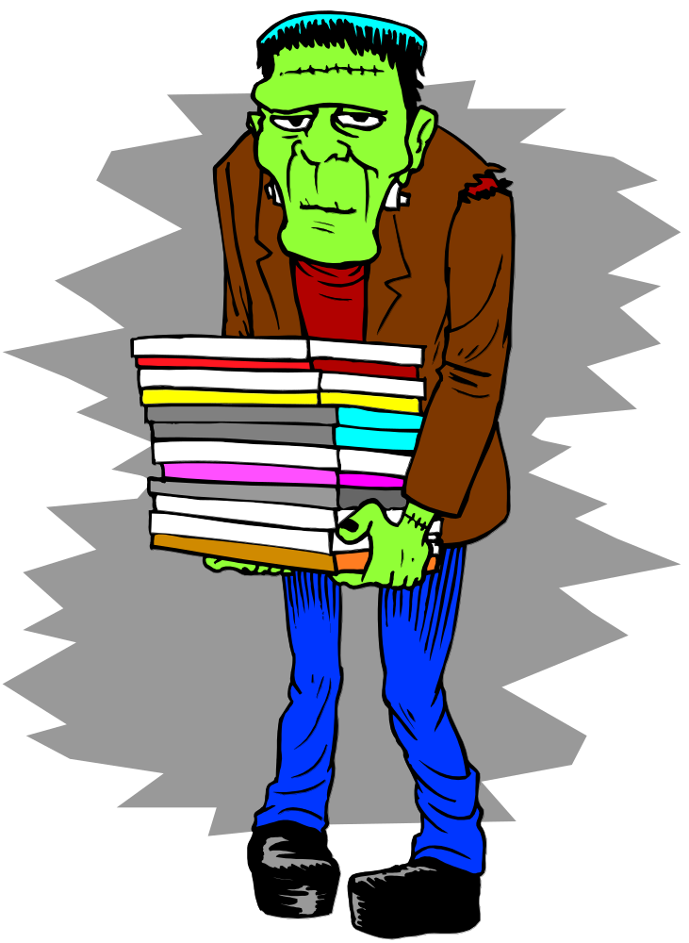
Citation Nightmares
Plagiarism/lack of originality
Self-plagiarism
Discovering the author never consulted sources cited
Discovering sources have never been checked
Discovering significant errors at the EIC edit (or after publication)
Claims of defamation by persons cited
Others?

Slide 5

Editor Training
Cite checking competency as selection criteria?
Citation/cite check training programs
  Before old board leaves
  Feedback
  Follow-up training
“Mock” technical edit on article
  “Lab sessions”
Involving faculty
Peer review

Slide 6
Member Training
Emphasize the substantive check
Initial and follow-up training
Break down the steps
Provide a checklist
Start with smaller assignments
Involve librarians
Feedback is key
AAARGH!

Slide 7
Due Diligence
“True or False: Information that is published can be trusted because someone other than the author --- an editor, a peer reviewer, a publisher, an institution --- has reviewed it first.”
Colleen Bell, University of Oregon Libraries, Critical Evaluation of Information Sources
(Web site attached)

Slide 8

The Search for Sources
Changes in types of sources cited
  Peer review v. student review
Changes in the availability of sources
Expectation that journal members will check sources
Request sources earlier rather than later
Build in process to withdraw an acceptance

Slide 9
Interviews
Ask the author for a transcript or notes
Ask the author for information about how to contact the person interviewed
Send the person interviewed the portions of the article that refer to the interview
  Ask the interviewee to verify the accuracy
Document with a letter to the interviewee

Slide 10
Unpublished Material
Ask the author for a copy
Red flags should pop up if the author cannot produce a copy, and cannot explain why
  Add a “presource” step before extending an offer?
Keep a copy on file at the law review --- permanently

Slide 11

E-mails
You must obtain a copy of the e-mail
  Authors expect you to ask for this type of information
  Ask earlier rather than later
APA Style Guide caution:
  “It is possible to send an email note disguised as someone else. Authors --- not journal editors or copy editors --- are responsible for the accuracy of all references, which includes verifying the source of email communications before citing them as personal communications in manuscripts.”

Slide 12
Web Sites
Print hard copies of online material
Check cites --- again --- just before sending issue to publisher
“Missing” Web sites
  Ask author for a hard copy
  Alternate engines (404 --- file not found)
  Archives
  Check the suffix (.com?), spelling, capitalization, and stray hyphens
  Cache option

Slide 13
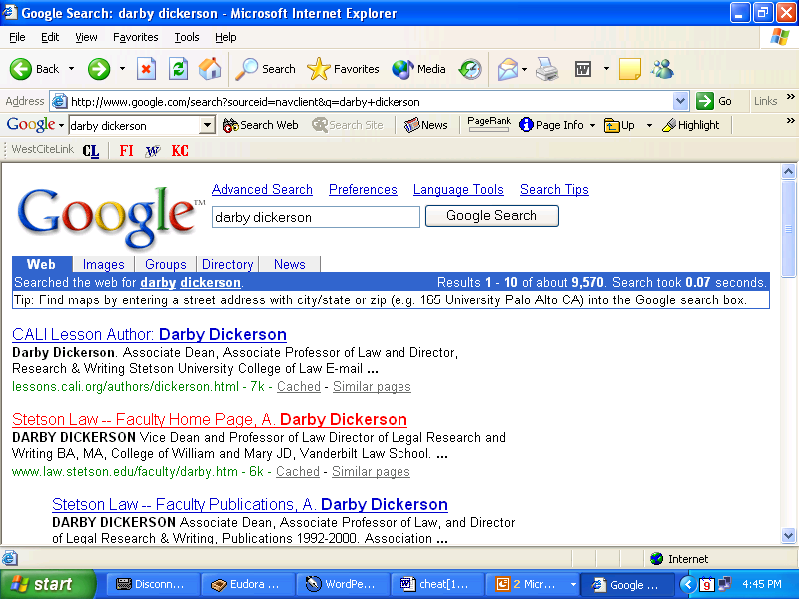

Slide 14
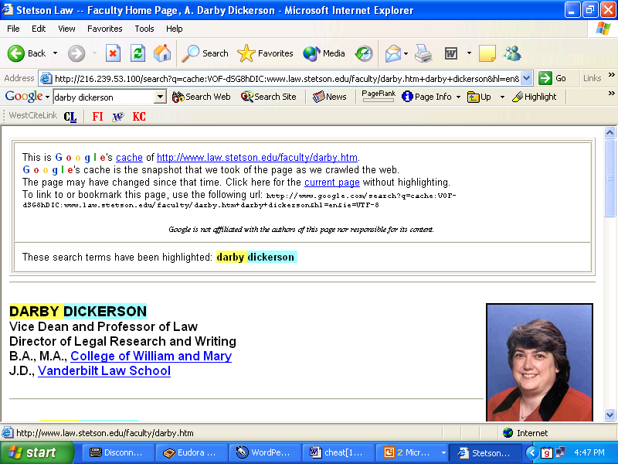

Slide 15
Web Site Credibility
If a paper contains many Web sites, evaluate credibility of support before issuing an offer
  Scholars of all sorts use Web-based material
  But, there is junk on the Web --- and a lot of it

Slide 16
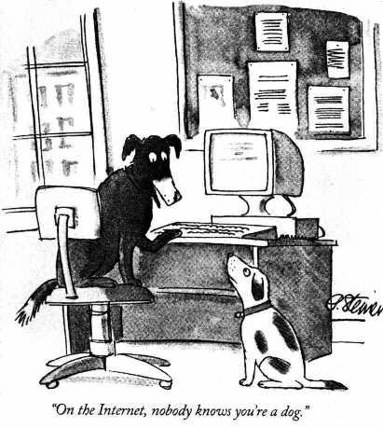

Slide 17
Evaluation Checklist
What type of site?
  .edu – educational institution (but, beware of links and “groups”)
  .gov – governmental organization
  .org – nonprofit organization
  .com – commercial organization
  .info – unrestricted (individuals and organizations)
  .biz – business or commercial purpose
  .name – individual
  .pro – professional (e.g., lawyers)
  .museum – museum
  .coop – business cooperative (e.g., credit unions)
  .aero – airport operator
Country codes

Slide 18
Checklist Continued
Author verified?
Objectivity?
Currency (date)?
  Can you determine the date?
Content reliable?
Can cited references be verified elsewhere?
Beware of links that take you “off site”

Slide 19

Videotapes, Audiotapes, and Music
Obtain the audiotape, videotape, cassette, DVD, etc
Look for “transcripts”
Have staff make a transcript of pertinent sections
Have a second person verify the transcript
Consider making these assignments during office hours or as assignments separate from the cite and source

Slide 20
Foreign-Language Material
Resolve source issues before issuing a publication offer
Does the author speak English?
Source in English?
Translation needed?
  Who will prepare?
  Who can verify?
  Copies of foreign-language original
Librarians and ILL (interlibrary loan)
How to verify?

Slide 21
Good Sources
University of Michigan Law Library, Foreign Legal Research (pathfinder)
  www.law.umich.edu/library/refres/foreign
University of Chicago, Finding Foreign Law Online When Going Global (including section on foreign law in English)
  http://www.lib.uchicago.edu/~llou/global.html
Georgetown University, Foreign Laws: English Translation Sources
  http://www.ll.georgetown.edu/intl/guides/english/
University of Illinois, Sources of International and Foreign Law in English
  http://www.law.uiuc.edu/library/home/netsourc/for_ljw2.htm

Slide 22
Other Sources
LLRX.com (country-specific guides)
  www.llrx.com/comparative_and_foreign_law.html
Foreign Law: Current Sources of Codes and Legislation in Jurisdictions of the World
  summary of legal system
  names of primary law sources
  citations to English language translations
  fee-based Web service with links to relevant Web sites
Martindale-Hubbell International Law Digest (English summaries of foreign laws)
Index to Foreign Legal Periodicals
Note re foreign language periodicals: Some carry articles in English; others provide English-language summary at the end of the article

Slide 23
Foreign Primary Law on the Web
www.findlaw.com
http://www.law.uh.edu/libraries/f&i/foreignlaw.html#Primary%20law%20sources%20by
http://www.law.cornell.edu/world/
www.law.nyu.edu/library/foreign_intl
www.loc.gov/law.glin

Slide 24
LEXIS and Westlaw
LEXIS: ArgentinaAustraliaBrazilBruneiCanada ChinaFranceGermanyHong KongHungary IndonesiaIrelandIsraelItalyMalaysiaMexico New ZealandNorthern IrelandPhilippinesRussia ScotlandSingaporeSouth AfricaSpainUnited Kingdom
Westlaw: AustraliaBrazilCanadaCayman Islands IranMexicoRussiaUnited Kingdom

Slide 25
Summary --- Nontraditional Sources
Evaluate sources carefully before extending an offer
Clause in publication agreement allowing withdrawal of offer
Clause re author cooperation
Use your librarians
Build in processes to ensure that sources have been checked
“See it for your own eyes” and “Don’t be afraid to ask”

Slide 26
Tips for Technical Editing

Slide 27
Aspects of Technical Editing
Readability
Conciseness
Consistency
Grammar, punctuation, mechanics
Citation form
Citation validation
Fact checking

Slide 28
Tips and Techniques
Large blocks of time
More than one reading
Quiet
Willingness to research technical issues
Rules v. preferences
Author’s voice (Sanger essay)
How technical changes affect substance
Same person v. different person
Proofreader’s marks/physical marking
Training and checklists
“Losing” changes

Slide 29

Sources for Technical Editing
Citation manuals
Citation helpers
Dictionaries
Grammar guides
Style guides
  Suggestion: Build a library in the journal office

Slide 30
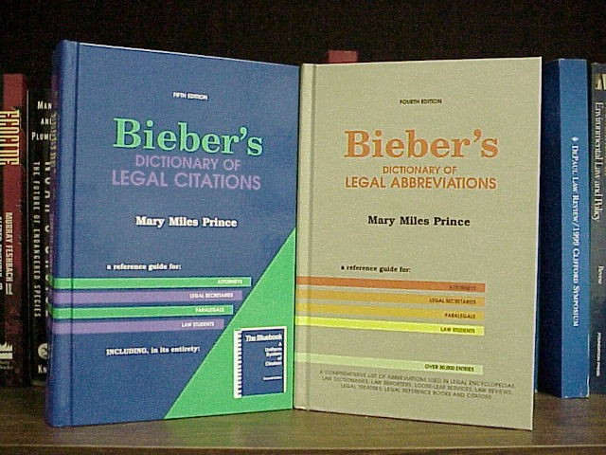

Slide 31
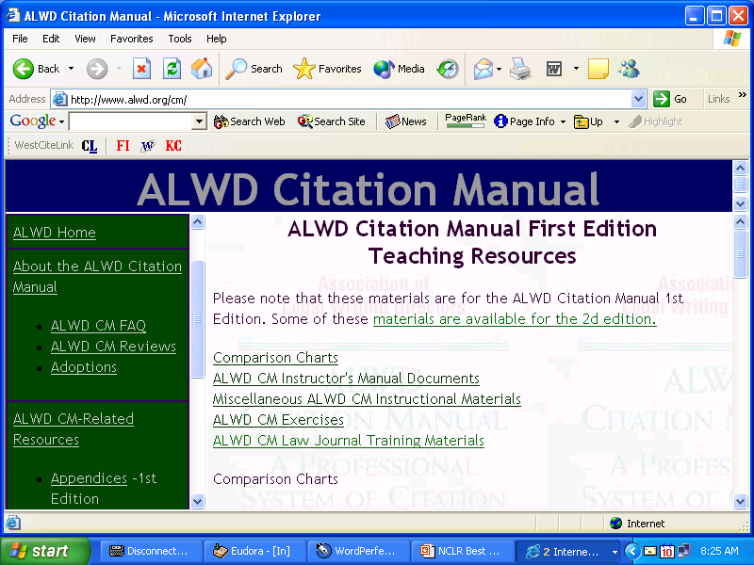

Slide 32
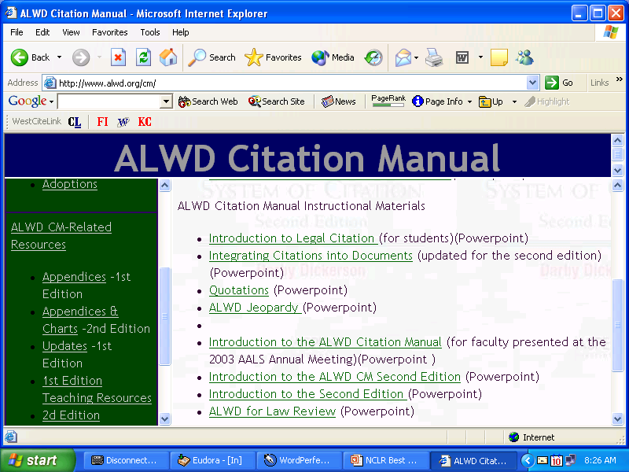

Slide 33
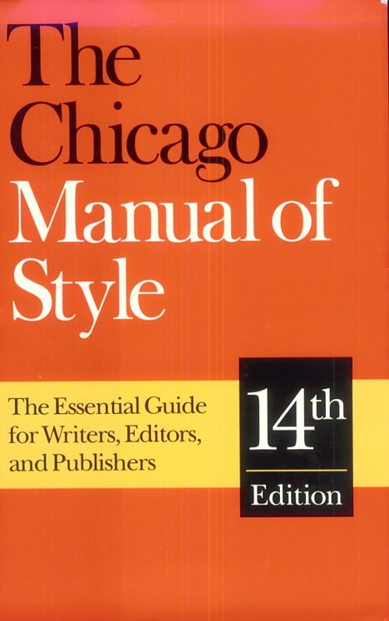
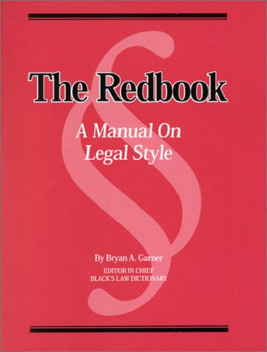

Slide 34
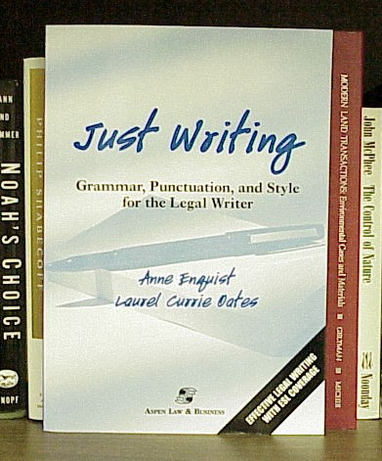
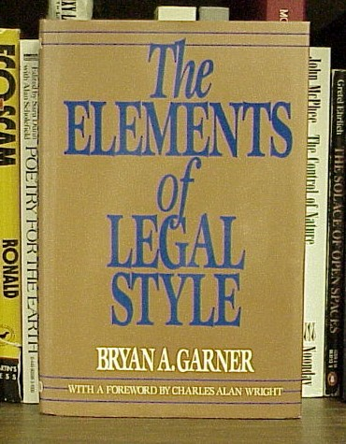

Slide 35
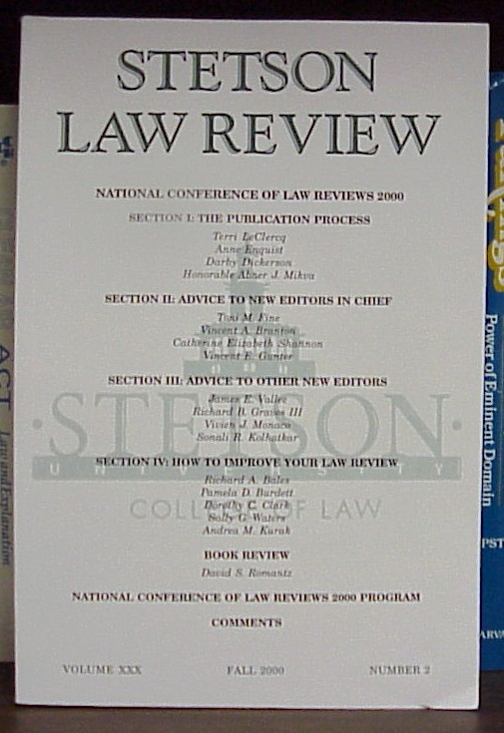

Slide 36

Questions?

